Slide 1




Play and Early Childhood Education
Course Reflection on Child’s Play
Karen Orman
Student 26027193
Stephen Berg, Professor
Play & Early Childhood Education
ECED-440
University of British Columbia
April 8, 2026

Slide 2

Table Of Contents
Foundations of Play
Observing, Documenting and Interpreting
Outdoor and Nature Play
Art for Child’s Play
Drama, Music & Movement
Language, Literacy, Math, Science and Play
Indigenous Perspectives, Technology and Other

Slide 3

Foundations
of Play
Play is a fundamental component of early
childhood development and learning
Jean Piaget emphasizes that play supports
cognitive development through stages such as symbolic and constructive play
Play promotes problem-solving, creativity, and independent thinking
Understanding play as meaningful learning
shifts away from traditional structured instruction

Slide 4

Observing, Documenting and Interpreting Children’s Play
Observation is a critical role of the educator
in understanding children’s learning
Documentation (learning stories, notes & photos)
help to capture children’s thinking and development
Supports reflective practice and intentional teaching strategies
Allows educators to respond to children’s interests and extend learning
Encourages deeper understanding of how play connects to developmental outcomes

Slide 5
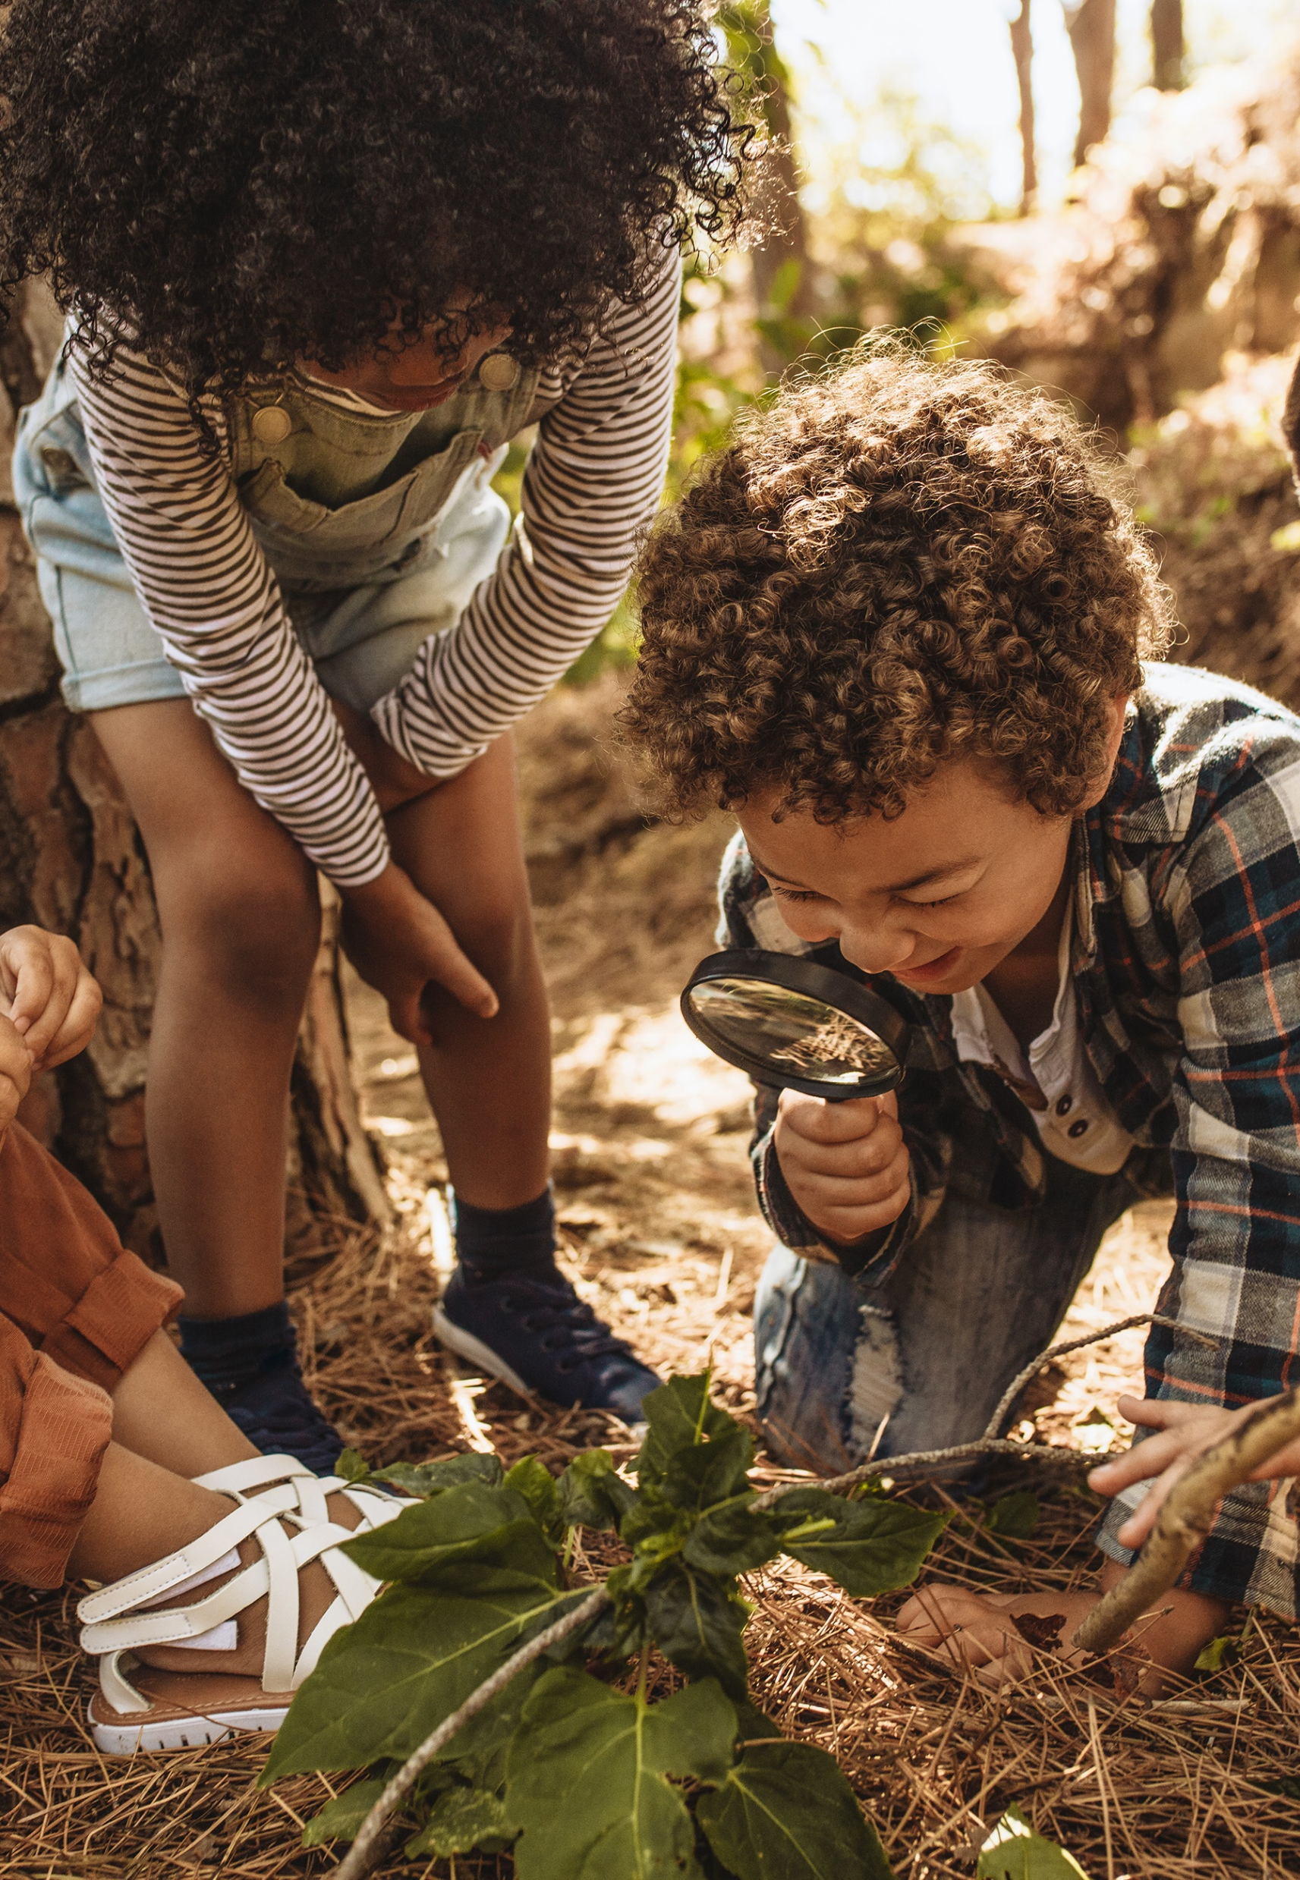
Outdoor and Nature Play & Planning Play Spaces
Outdoor and nature-based play supports physical, emotional, and cognitive development
Outdoor environments encourage exploration, curiosity, and risk-taking which enhances motor skills, coordination, and overall well-being
Provides sensory-rich experiences that cannot be replicated indoors - Supports resilience, independence, and connection to a natural environment

Slide 6

Art provides children with opportunities for creativity, expression, and communication
Encourages imagination and exploration of materials
Supports cognitive development through problem-solving and decision-making
Aligns with approaches such as Reggio Emilia, where children express learning in multiple ways - Emphasizing creativity, and exploration using emotions, and experiences
Art & Play

Slide 7

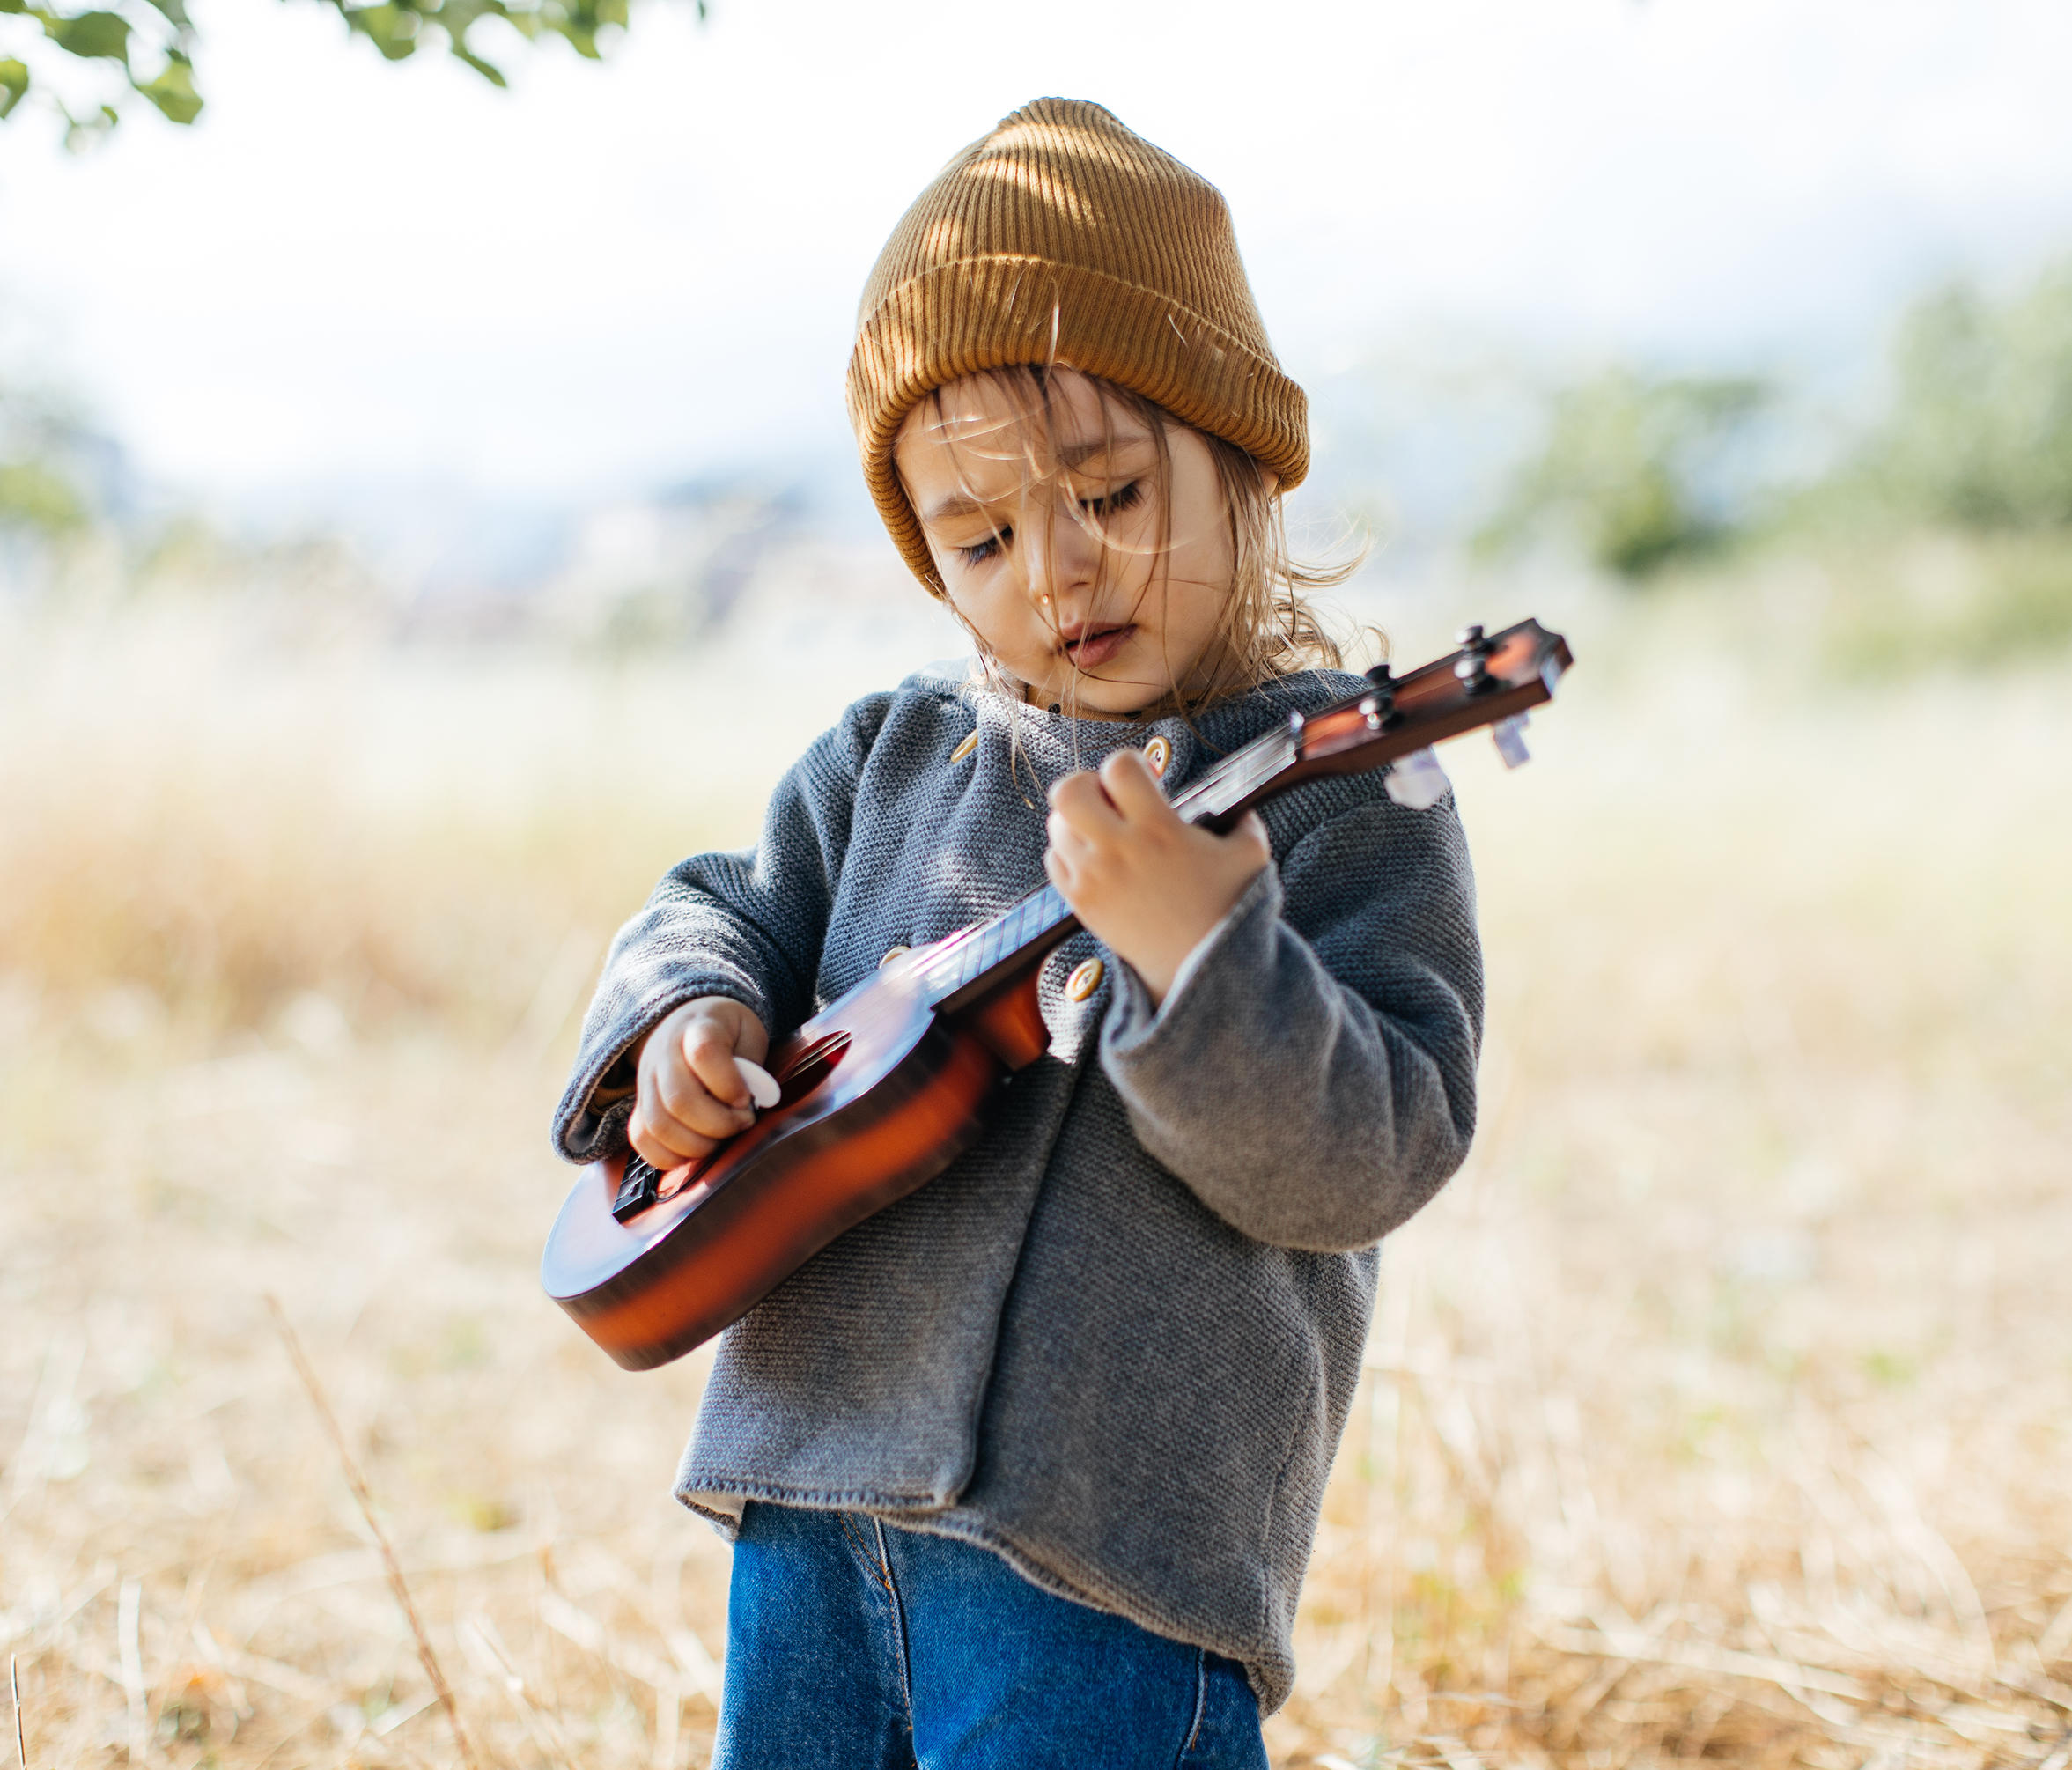
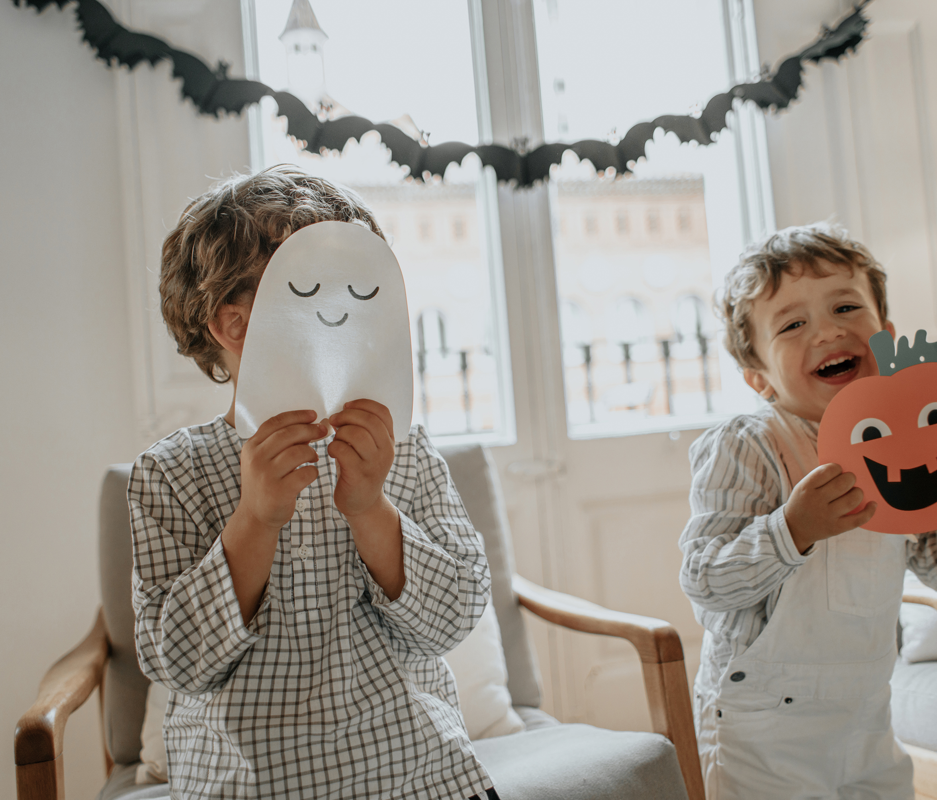

Drama, Music & Movement for Play
Dramatic play supports social, emotional, and language development
Children engage in role-playing, storytelling, and symbolic representation
Builds communication skills, empathy, and collaboration
Movement and music enhance physical development and coordination
Play integrates mind and body, supporting holistic development

Slide 8

Language, Literacy, Math, Science & Play
Play-based learning supports early literacy through conversation, storytelling, and interaction
Develop numeracy skills through counting, sorting, and problem-solving
Encourages inquiry-based learning and scientific thinking
Lev Vygotsky highlights the importance of social interaction in learning - Play provides meaningful, real-world contexts for developing foundation
.
01

Slide 9


Indigenous Perspectives, Technology and Other Aspects of Child’s Play
Inclusive play ensures all children can participate regardless of ability or background & recognizes diverse learning styles and strengths
Indigenous perspectives emphasize connection, community, and holistic learning
Technology can support learning when used intentionally and appropriately
Educators must create equitable, accessible, and culturally responsive environments

Slide 10

Two New Sources:
Peer Reviews
Research shows that play, particularly pretend
play, supports cognitive and social development
(Lillard et al., 2013)
Guided play provides a balance between child-led exploration and intentional teaching, supporting meaningful learning outcomes
(Weisberg et al., 2013)

Slide 11

Reflection
I now have a further appreciation for the role of play which helps children learn. Free play is actually a richly complex activity involving discovery, conversation, and interpersonal communication. The benefits of play is not limited to brain development, but rather can address all aspects of development.
Piaget and Vygotsky supports the notion that play has an individual and collective value. Piaget, in his constructivist theory, views children as active participants, while Vygotsky highlights the value of social interaction. Reggio Emilia and similar approaches emphasize the importance and value of play in learning as children utilize their environment, imagination, and constructive purpose.
Play is a fundamental component of life, in addition to be being enjoyable, it is a critical component of learning and development, and it is exciting to watch children both explore & learn, and I can’t wait to further enhance my understandings in this area.
Karen

Slide 12
References
Carr, M. (2001). Assessment in early childhood settings: Learning stories. Sage.
Edwards, C., Gandini, L., & Forman, G. (2012). The hundred languages of children: The Reggio Emilia
experience in transformation (3rd ed.). Praeger.
Fjørtoft, I. (2004). Landscape as playscape: The effects of natural environments on children’s play and motor development. Children, Youth and Environments, 14(2), 21–44.
Hirsh-Pasek, K., Golinkoff, R. M., & Eyer, D. (2009). A mandate for playful learning in preschool: Presenting the evidence. Oxford University Press.
Lillard, A. S., Lerner, M. D., Hopkins, E. J., Dore, R. A., Smith, E. D., & Palmquist, C. M. (2013). The impact of pretend play on children’s development: A review of the evidence. Psychological Bulletin, 139(1), 1–34. https://doi.org/10.1037/a0029321
Louv, R. (2005). Last child in the woods: Saving our children from nature-deficit disorder. Algonquin Books.
Piaget, J. (1962). Play, dreams and imitation in childhood. Norton.
Vygotsky, L. S. (1978). Mind in society: The development of higher psychological processes. Harvard University Press.
Weisberg, D. S., Hirsh-Pasek, K., & Golinkoff, R. M. (2013). Guided play: Where curricular goals meet a playful pedagogy. Mind, Brain, and Education, 7(2), 104–112. https://doi.org/10.1111/mbe.12015

